Slide 1
iPhone/iPAD Development
(Objective-C Basics)

Slide 2
Introduction
Objective-C is a general-purpose, object-oriented programming language that adds Smalltalk-style messaging to the C programming language.
It’s a superset of the C programming language and provides object-oriented capabilities and a dynamic runtime.
Objective-C inherits the syntax, primitive types, and flow control statements of C and adds syntax for defining classes and methods.

Slide 3
Introduction
This is the main programming language used by Apple for the OS X and iOS operating systems and their respective APIs, Cocoa and Cocoa Touch.
It also adds language-level support for object graph management and object literals while providing dynamic typing and binding, deferring many responsibilities until runtime.
It also fully supports object-oriented development −
  Encapsulation
  Data hiding
  Inheritance
  Polymorphism

Slide 4
Local Environment Setup
If you are willing to set up your environment for Objective-C programming language, you need the following two softwares available on your computer,
  Text Editor and
  The GCC Compiler
In order to run Objective-C program on windows, we need to install MinGW and GNUStep Core. Both are available at https://www.gnu.org/software/gnustep/windows/installer.html.
First, we need to install the MSYS/MinGW System package. Then, we need to install the GNUstep Core package. Both of which provide a windows installer, which is self-explanatory.

Slide 5
Local Environment Setup
Then to use Objective-C and GNUstep by selecting Start -> All Programs -> GNUstep -> Shell

Slide 6
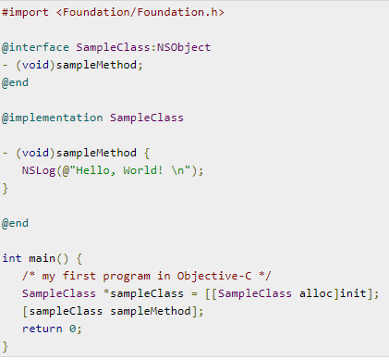
Objective-C Program Structure
A Objective-C program basically consists of the following parts:-
  Preprocessor Commands
  Interface
  Implementation
  Method
  Variables
  Statements and Expressions
  Comments

Slide 7
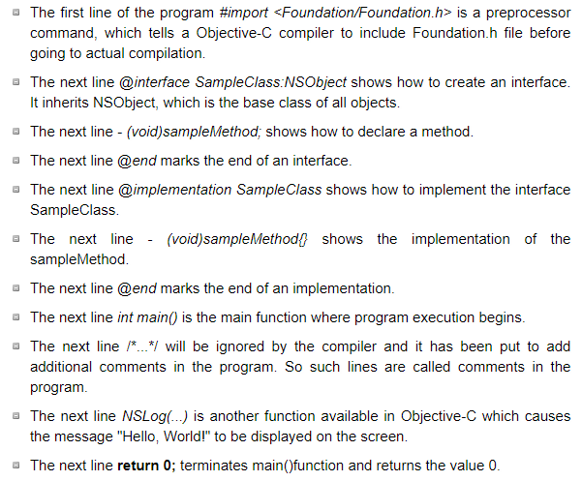
Objective-C Program Structure

Slide 8
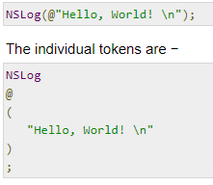
Tokens in Objective-C
A Objective-C program consists of various tokens and a token is either a keyword, an identifier, a constant, a string literal, or a symbol. For example, the following Objective-C statement consists of six tokens −

Slide 9


Comments
Comments are like helping text in your Objective-C program and they are ignored by the compiler. They start with /* and terminate with the characters */ as shown below −
Identifiers
An Objective-C identifier is a name used to identify a variable, function, or any other user-defined item. An identifier starts with a letter A to Z or a to z or an underscore _ followed by zero or more letters, underscores, and digits (0 to 9).
Objective-C does not allow punctuation characters such as @, $, and % within identifiers. Objective-C is a case-sensitive programming language. Thus, Manpower and manpower are two different identifiers in Objective-C. Here are some examples of acceptable identifiers:

Slide 10
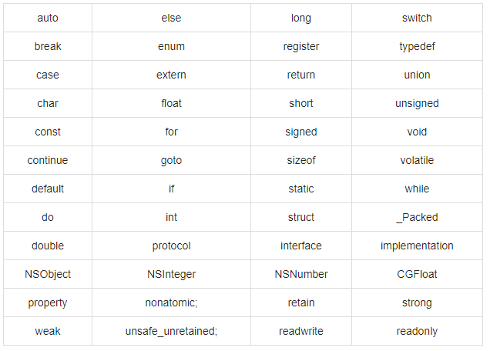
Keywords
The following list shows few of the reserved words in Objective-C. These reserved words may not be used as constant or variable or any other identifier names.

Slide 11
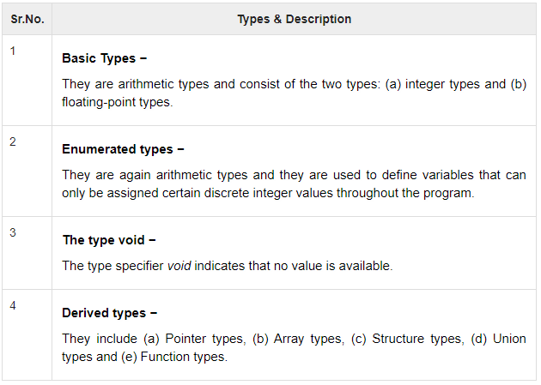
Data Types
In the Objective-C programming language, data types refer to an extensive system used for declaring variables or functions of different types. The type of a variable determines how much space it occupies in storage and how the bit pattern stored is interpreted.
The types in Objective-C can be classified as follows −

Slide 12
Variables
A variable is nothing but a name given to a storage area that our programs can manipulate. Each variable in Objective-C has a specific type, which determines the size and layout of the variable's memory; the range of values that can be stored within that memory; and the set of operations that can be applied to the variable.
The name of a variable can be composed of letters, digits, and the underscore character. It must begin with either a letter or an underscore. Upper and lowercase letters are distinct because Objective-C is case-sensitive. Based on the basic types explained in previous slide, there will be the following basic variable types −char, int, float, double and void.

Slide 13
Constants
The constants refer to fixed values that the program may not alter during its execution. These fixed values are also called literals.
Constants can be of any of the basic data types like an integer constant, a floating constant, a character constant, or a string literal. There are also enumeration constants as well.
The constants are treated just like regular variables except that their values cannot be modified after their definition.

Slide 14
Operators
An operator is a symbol that tells the compiler to perform specific mathematical or logical manipulations. Objective-C language is rich in built-in operators and provides following types of operators −
  Arithmetic Operators
  Relational Operators
  Logical Operators
  Bitwise Operators
  Assignment Operators
  Misc Operators

Slide 15
Loops
There may be a situation, when you need to execute a block of code several number of times. In general, statements are executed sequentially: The first statement in a function is executed first, followed by the second, and so on.
Programming languages provide various control structures that allow for more complicated execution paths.
A loop statement allows us to execute a statement or group of statements multiple times.

Slide 16
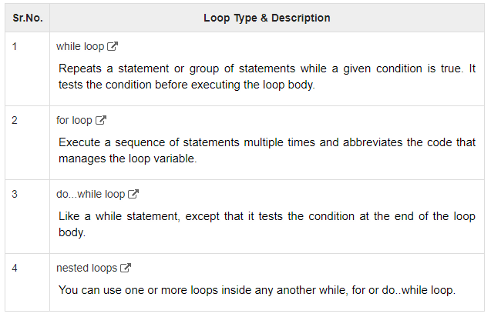
Loops

Slide 17
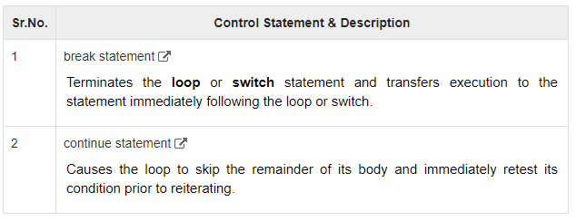
Loop Control Statements

Slide 18
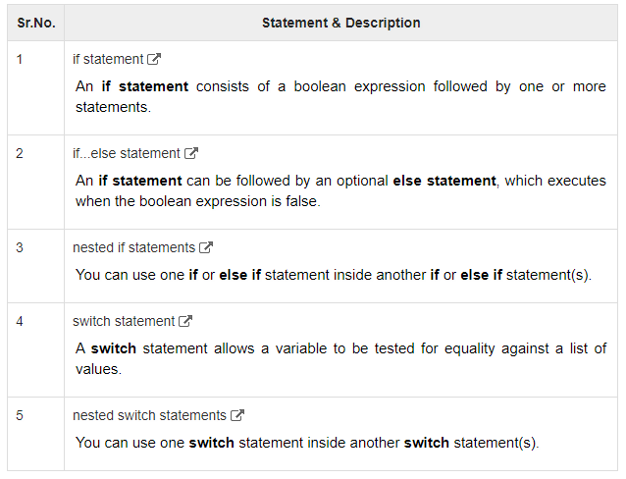
Decision Making
Decision making structures require that the programmer specify one or more conditions to be evaluated or tested by the program, along with a statement or statements to be executed if the condition is determined to be true, and optionally, other statements to be executed if the condition is determined to be false.

Slide 19
Functions
A function is a group of statements that together perform a task. Every Objective-C program has one C function, which is main(), and all of the most trivial programs can define additional functions.
You can divide up your code into separate functions. How you divide up your code among different functions is up to you, but logically the division usually is so each function performs a specific task.
A function declaration tells the compiler about a function's name, return type, and parameters. A function definition provides the actual body of the function.
Basically in Objective-C, we call the function as method.
The Objective-C foundation framework provides numerous built-in methods that your program can call. For example, method appendString() to append string to another string.
A method is known with various names like a function or a sub-routine or a procedure, etc.

Slide 20
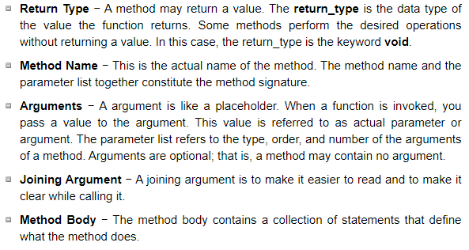
Functions
A method definition in Objective-C programming language consists of a method header and a method body. Here are all the parts of a method −

